Slide 1
Module 5 Reference Variables
Computer Science 2

Slide 2
Data representation
Primitive variables
int
char
boolean
double
etc
Reference Variables
String
Arrays
Objects (Scanner, Person, Animal, etc)

Slide 3
Initial values for primitive variables
byte var1; // initial value = 0
short var2; // initial value = 0
int var3; // initial value = 0
long var4; // initial value = 0L
float var5; // initial value = 0.0f
double var6; // initial value = 0.0d
char var7; // initial value = '\u0000’
boolean flg; // initial value = false
Object var8; // initial value = null
String var9; // initial value = null
int[] var10; // initial value = null

Slide 4
Reference Variables
All reference variables (Objects, arrays, Strings) start with an initial value of null.
What is null?
null is a special constant you can point to whenever you wish to point to the absence of a value.

Slide 5
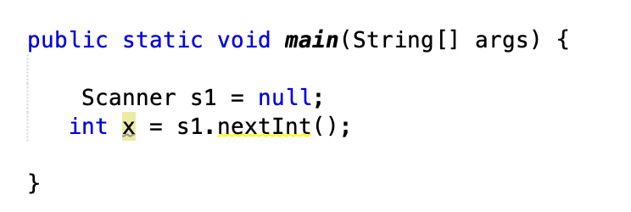
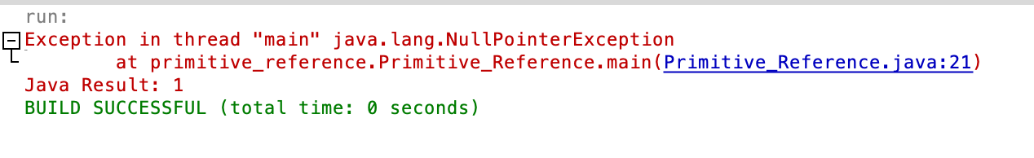
Reference Variables
Any reference variable can be assigned a value of null. If we try to call an instance method of an object that has not been initialized, we will see the NullPointerException error.

Slide 6
byte var1;
short var2;
int var3;
String var9;
int[] var10;
Object var11;
Variable name
Initial value
Memory location
Variable name
Initial value
Memory location
var1 = 10;
var2 = 3;
var3 = 17;
var9 = "Hola";

Slide 7
Variable name
Initial value
Memory location
var10 = new int[3];
var11 = new Object();

Slide 8
The difference between a primitive variable and a reference variable is now information is stored in memory.
Primitive variable contents store information directly (They have an already defined length!)
Reference variables store a pointer to a memory location where the data is stored. This is because the size of the data is defined during runtime.
Variable name
Initial value
Memory location

Slide 9
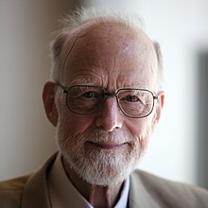
“I call it my billion-dollar mistake(…). Null references were created in 1964 - how much have they cost? (...)
This has led to innumerable errors, vulnerabilities, and system crashes, which have probably caused a billion dollars of pain and damage in the last forty years.”
Sir Charles Anthony Richard Hoare

Slide 10
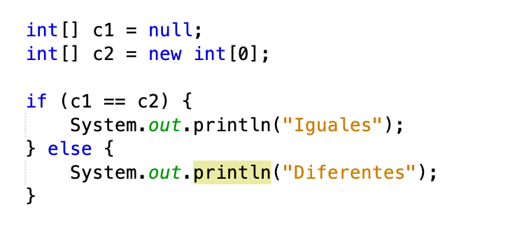
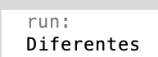
Reference Variables
When comparing reference variables, the == operator does not work.
null is a reserved word.

Slide 11
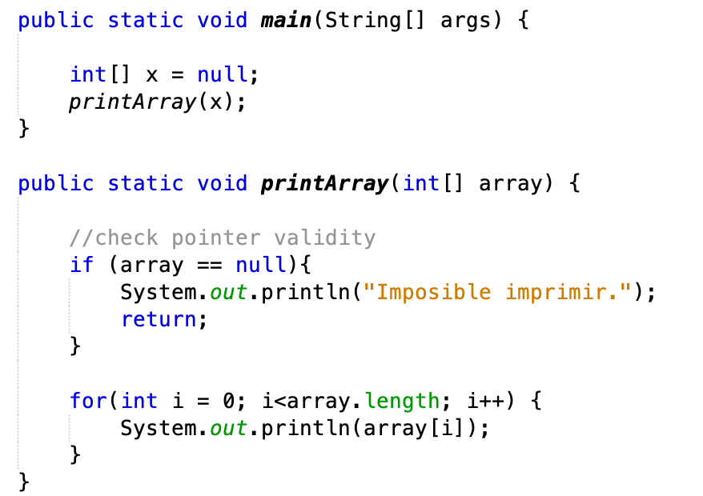
Reference Variables
You can void issues by checking pointer validity before using object attributes or methods.

Slide 12
UML Notation

Slide 13
UML Notation
Unified Model Language is a series of visual standards to provide a way to represent the design of a system.

Slide 14
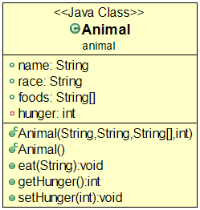
public class Animal2 {
public String name;
public String race;
public String[] foods;
private int hunger;
public Animal(String name, String race,
String[] foods, int hunger) {}
public Animal() {}
public void eat(String inputFood) {}
public int getHunger() {}
public void setHunger(int hunger) {}
}

Slide 15
What is being modeled (optional)
Class name
Package (optional)

Slide 16

Attribute list
Access modifier
Variable name
:
Data type
Another way of representing the access modifiers is by using the plus and minus signs.
+ for public
- for private

Slide 17
Methods
Access modifier
Method name
Parameter list
:
Return value
The parameter list can also be specified using the following format
name: data type

Slide 18
Exercise
We want to represent a Classroom full of Students.
Each instance of a Student must be able to store a name and their student id.
Each Classroom must be able to hold an array of students, with the room where the class takes place.
Student classroom

Slide 19
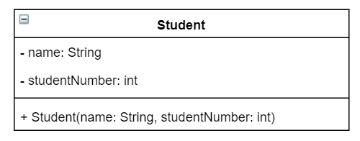
Exercise: Student classroom

Slide 20
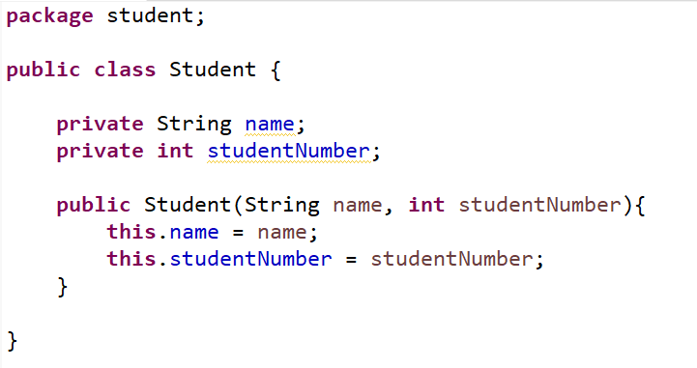
Exercise: Student classroom

Slide 21
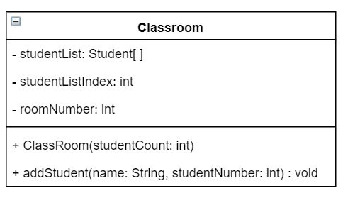
Exercise: Student classroom

Slide 22
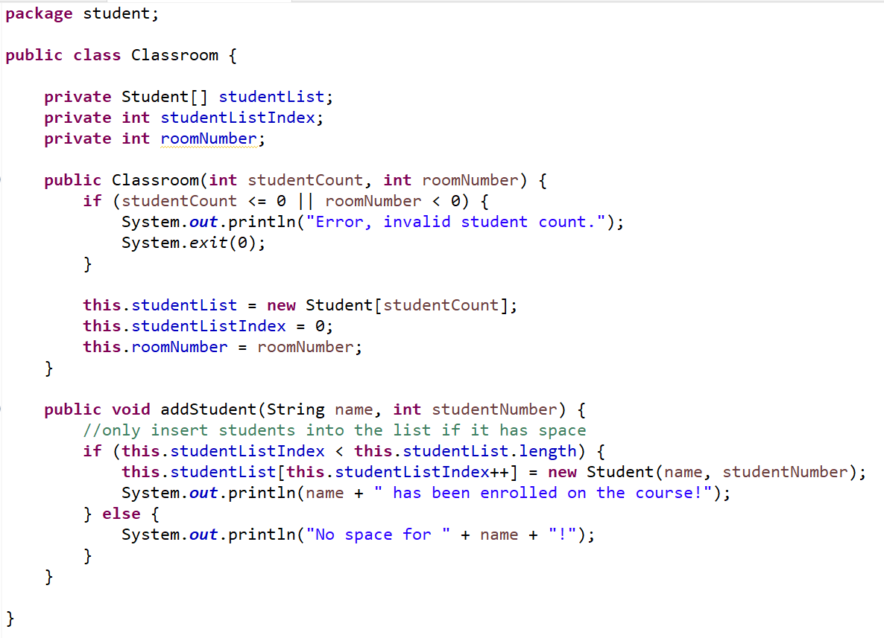
Exercise: Student classroom

Slide 23
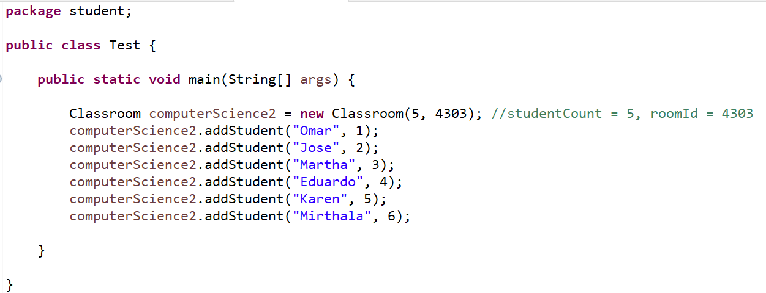
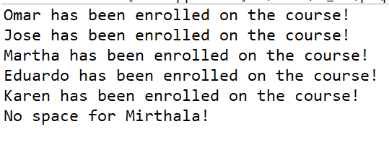
Exercise: Student classroom
OUTPUT

